Slide 1

microServiceBus.com
tutorial
Mikael Hakansson
mikael.hakansson@axians.com
Aleyois Boix Chova
aleyois.boix-chova@axians.com
Patrik Sohlman
patrik.sohlman@axians.com

Slide 2
Day 2
Day 1 Recap
Create IoT Hub and mSB Organization
Integrate Cisco Jasper
Provisioning new gateways
IoT Message Exchange Patterns
Common IoT protocols (skapa slides)
Build a real world sensor to cloud solution
Lab
1. Receive whitelist through state
2. Read telegrams from sensors and send to cloud
3. Create Azure Event Hub and Time Series Insight

Slide 3






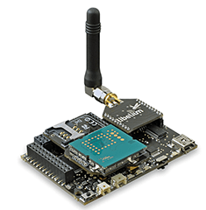













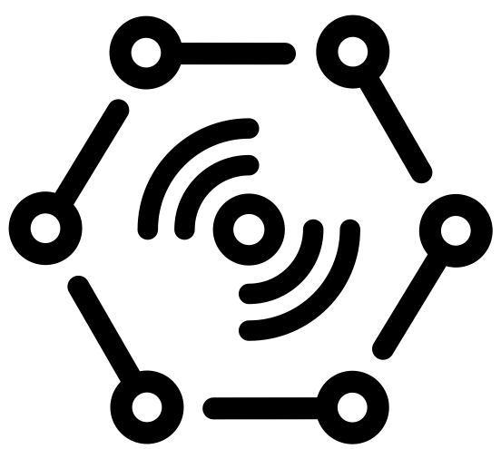





Challenges
Onboarding
Hub independence
Updates & Patches
Issue tracking
Monitoring
Reports
“Any DEvice”
Value
Apps
DATA
“Any Data Source”
“Any IoT platform”
Monitoring
“Any PROTOCOL”
Machine
Learning
PROTOCOL
DATA
LOB
Modbus
Wi-Fi
LoRa
Serial

Slide 4





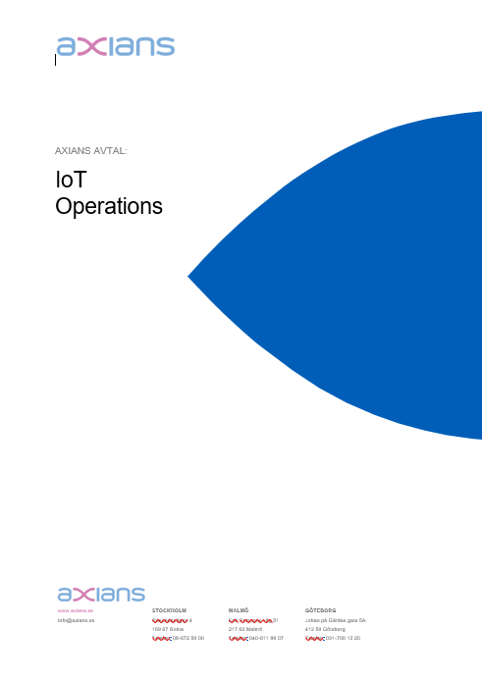
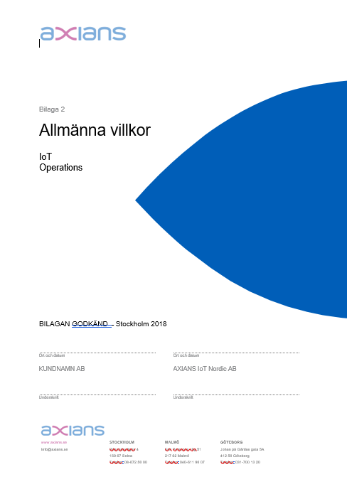
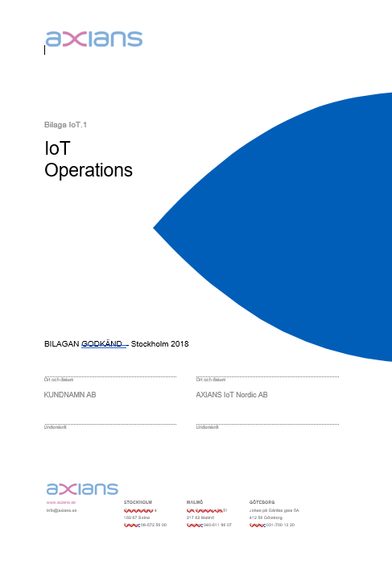
IoT Operations generic offering
IoT Nordic
PLC’s
Machines, Sensors,
meters etc...
Gateway (Devices)
Communi-cation
Cloud
IoT Operations
Business Solution
Set price per device & month.

Slide 5
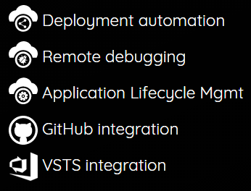


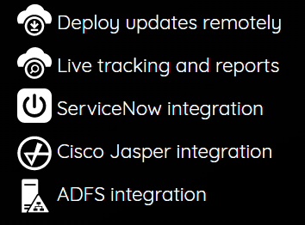


Axians – IoT Operation
Device Mgmt
Customer A
IOT HUB
Customer B
IOT HUB
Customer C
IOT HUB

Slide 6



Axians – IoT Operation
Device Mgmt
Customer A
IOT HUB
SERVICE DESK
Customer B
IOT HUB
NETWORK OPERATIONS CENTER
Customer C
IOT HUB

Slide 7
Axians – IoT Operation
Device Mgmt
Customer A
IOT HUB
Incidents
Issue tracking
Problem Management
Change Management
Release Management
Knowledge base
ITIL
SERVICE DESK
Customer B
IOT HUB
NETWORK OPERATIONS CENTER
Customer C
IOT HUB

Slide 8
IoT platforms
Certificates
SAS
Revoke
Sensor
Data
GATEWAY/ DEVICE
Transport
SECURITY
RULES & ROUTING
REPORTS
SQL / NOSQL
DEVICE MGMT
ERP / LOB
API
API
Node.js
ARM mbed
Java
.Net
Python
MQTT
AMQP
WebSockets
HTTP
Add/Remove
Enable/Disable
Metadata
State

Slide 9

microServiceBus Architecture (node.js)
Field Gateway
Interacting with sensors & business logic
Frequently updates (weekly)
Service
Service
Service
Responsible for IoT Hub & orchestration of services
Often updates (once or twice a month)
Agent
microServiceBus-core
Responsible for communication with mSB.com
Rarely updates (once or twice a year)
Agent
microServiceBus-node
Platform
Node.js
Operating system
Linux

Slide 10





microServiceBus.com and related projects are property of Vinci-Energies!

Slide 11

What is Node.js?
Node.js® is a JavaScript runtime built on Chrome's V8 JavaScript engine.
Node.js uses an single threaded, event-driven, non-blocking I/O model that makes it lightweight and efficient.
Node.js is platform independent.

Slide 12

What is JavaScript?
A high-level, dynamic, untyped, and interpreted programming language. It has been standardized in the ECMAScript language specification
Notes:
High-level … förlåtande
Förklara att javascript är ett JIT kompilerat språk
var a = 2;
console.log(a);
3();

Slide 13

Node Package Manager (NPM)
npm is the default package manager for the JavaScript runtime environment Node.js and allows users to consume and distribute JavaScript modules that are available on the registry.
Npm has over 500K+ packages today, which is almost as much as Java, .Net and Python combined!

Slide 14
microServiceBus.com - Key concepts
Organization
“Subscription” owning flows, services & nodes
Services
Nodes
Cloud connected agent, hosting one or more flows
Code interacting with HW or other services
Inbound service
Outbound service
Other service
Flows
Process execution of services

Slide 15
Day 2
Day 1 Recap
Create IoT Hub and mSB Organization
Integrate Cisco Jasper
Provisioning new gateways
IoT Message Exchange Patterns
Common IoT protocols
Build a real world sensor to cloud solution
Lab
1. Receive whitelist through state
2. Read telegrams from sensors and send to cloud
3. Create Azure Event Hub and Time Series Insight

Slide 16
Lab #1 Create IoT Hub and mSB Organization

Slide 17
Day 2
Day 1 Recap
Create IoT Hub and mSB Organization
Integrate Cisco Jasper
Provisioning new gateways
IoT Message Exchange Patterns
Common IoT protocols
Build a real world sensor to cloud solution
Lab
1. Receive whitelist through state
2. Read telegrams from sensors and send to cloud
3. Create Azure Event Hub and Time Series Insight

Slide 18




On-boarding
4. Register device
3. Notification
IOT HUB
SIM CARD MANAGEMENT
IoT Hub
microServiceBus.com
DEVICE MANAGEMENT
5. Credentials
6. Config
2. Request config
?
7. Send & Receive
1. Activate SIM card
IOT DEVICE

Slide 19
Lab #1 Integrate Cisco Jasper
Instance: https://restapi3.jasper.com/rws/api/v1
User name: TUTORIALAPI
REST API key: 52098541-a1ed-4a33-84a2-13fbbf5723e2
Shared secret: Ignore
Trainer email: aleyois.boix-chova@axians.com

Slide 20
Day 2
Day 1 Recap
Create IoT Hub and mSB Organization
Integrate Cisco Jasper
Provisioning new gateways
IoT Message Exchange Patterns
Common IoT protocols
Build a real world sensor to cloud solution
Lab
1. Receive whitelist through state
2. Read telegrams from sensors and send to cloud
3. Create Azure Event Hub and Time Series Insight

Slide 21
Lab #1 Provisioning new gateways

Slide 22
Day 2
Day 1 Recap
Create IoT Hub and mSB Organization
Integrate Cisco Jasper
Provisioning new gateways
IoT Message Exchange Patterns
Common IoT protocols
Build a real world sensor to cloud solution
Lab
1. Receive whitelist through state
2. Read telegrams from sensors and send to cloud
3. Create Azure Event Hub and Time Series Insight

Slide 23

IoT Message Exchange Patterns
Events
Messaging
Methods
State
Massive stream of information. Managed outside the IoT Hub
C2D communication using a pub/sub pattern using topics & subscriptions
Devices exposes methods that can called from a external applications using a request/response pattern
Device state is exchanged using device-twin configuration stored in the IoT Hub.

Slide 24








IoT Message Exchange Patterns
Events
Devices
IoT Hub
Machine Learning
Cosmo DB
Stream Analytics
Messaging
Function App
Logic App
Custom

Slide 25
IoT Message Exchange Patterns
State
Devices
IoT Hub
Function App
Twin
Tags
Desired
Logic App
Reported
Custom

Slide 26
Day 2
Day 1 Recap
Create IoT Hub and mSB Organization
Integrate Cisco Jasper
Provisioning new gateways
IoT Message Exchange Patterns
Common IoT protocols
Build a real world sensor to cloud solution
Lab
1. Receive whitelist through state
2. Read telegrams from sensors and send to cloud
3. Create Azure Event Hub and Time Series Insight

Slide 27
Common IoT protocols

Slide 28
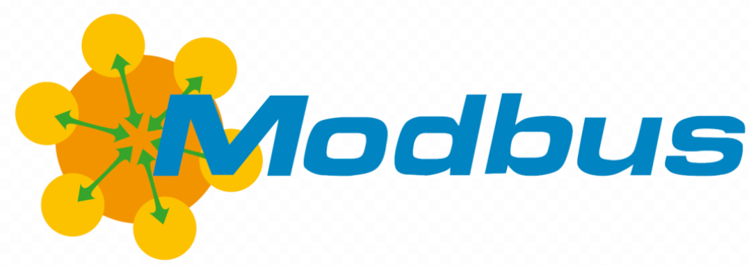
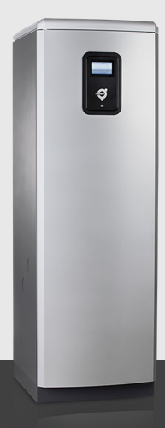
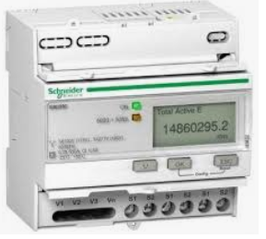
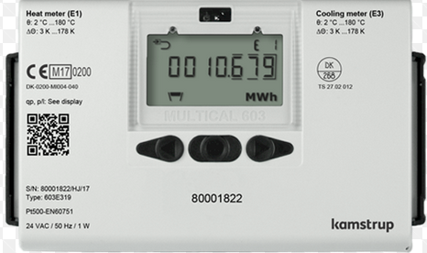
Common IoT protocols
De facto standard communication protocol, widely spread for connecting industrial electronic devices.
Devices: Heat pumps, energy meters, PLC, …
Other versions: Modbus RTU, Modbus TCP, …

Slide 29
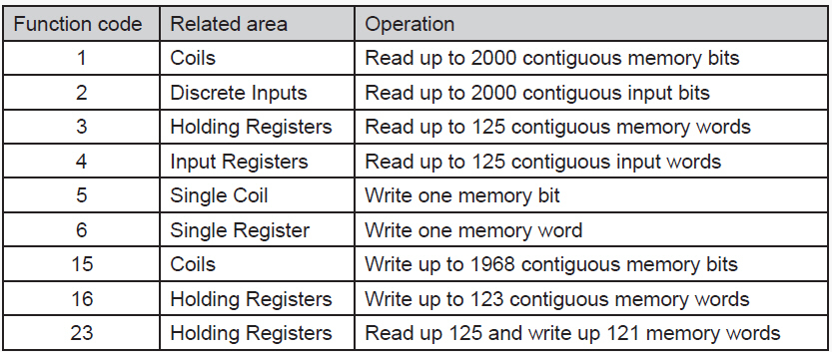
Modbus – function codes

Slide 30
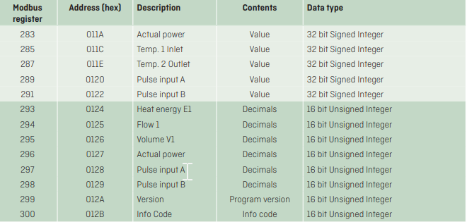
Modbus – data formatting
Holding registers
31 44 b0 5c 82 86 00 02 1b 7a fb 00 00 00 2f 00 02 1b 7a fb 00 00 02 1b 7a fb 00 00 00 2f 00 2f 2f 0a 66 34 02 0a 02 1b 7a fb 00 00 00 2f
02 1b 7a fb 00 00 00 2f fb 1a 45 02 02 02 1b 7a fb 00 00 00 2f fd 97 1d 00 00 2f 2f 2f 2f 2f 2f 2f 2f 2f 2f 2f 2f 2f 2f 2f 41 f8 9b 02 02 1b 7a
Slave ID
Data
Position 291
01 03 97 1d 02 1b
= 151 29
151 + (29 X 16) = 615
Function code
Message
Check sum

Slide 31

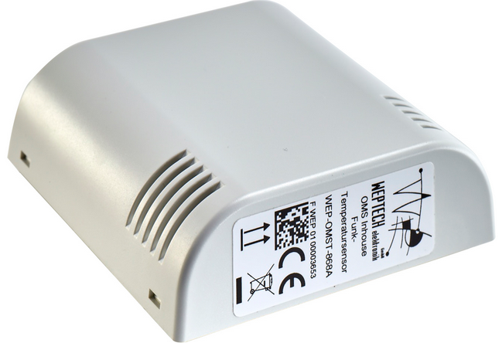
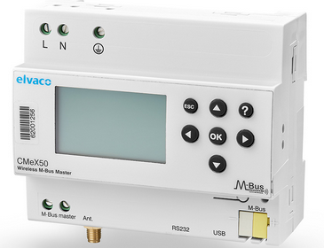
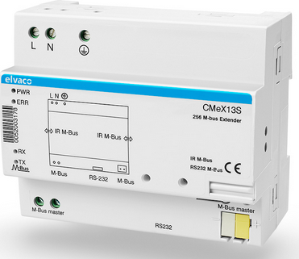
Common IoT protocols
M-bus (Meter-Bus) standardized protocol for remote reading of meters.
Other versions: Wireless M-bus.

Slide 32
Wireless M-Bus
31 44 b0 5c 82 86 00 00 02 1b 7a fb 00 00 00 2f 2f 0a 66 34 02 0a fb 1a 45 02 02 fd 97 1d 00 00 2f 2f 2f 2f 2f 2f 2f 2f 2f 2f 2f 2f 2f 2f 2f 41 f8 9b
Header
Body

Slide 33
Wireless M-Bus - Header
Manufacturer
Type
Length
31 44 b0 5c 82 86 00 00 02 1b 7a
Device Id
Sensor Id
Version
000086825cb0021b

Slide 34
Wireless M-Bus

Slide 35
Day 2
Day 1 Recap
Create IoT Hub and mSB Organization
Integrate Cisco Jasper
Provisioning new gateways
IoT Message Exchange Patterns
Common IoT protocols
Build a real world sensor to cloud solution
Lab
1. Receive whitelist through state
2. Read telegrams from sensors and send to cloud
3. Create Azure Event Hub and Time Series Insight

Slide 36




Getting Started
Sensor
Gateway
Azure
IoT Hub
Azure
Event Hub
Time Series Insight
microServiceBus.com

Slide 37
Build a real world sensor to cloud solution
Lab
1. Receive whitelist through state
2. Read telegrams from sensors and send to cloud
3. Create Azure Event Hub and Time Series Insight

Slide 38











Patterns and best practices
Gateways
IoT Hubs
Event Hubs
Functions
Event Hubs
Functions
Data
Business applications
Organization
IoT Hubs
Event Hubs
Functions
Data
Scenario 1
Event Hubs
Functions
Data
Scenario 2
Organization

